Slide 1
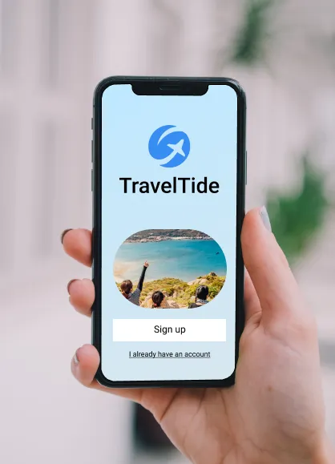

Travel Tide Project
MASTERsCHOOL Mastery Project presentation
Conducted by oytun cevre
Date of submission: 30.11.2024

Slide 2
Introduction
Goal of the project
Explanation of the customer group divisions
Definitions of the perks for each customer group
Age group distribution and perks
Customer groups according to the countries USA & Canada
Recommendations
Resources

Slide 3
Goal of the Project
Travel Tide, is a growing e-booking platform powered by advanced technology, which is making steady progress in the online travel industry.
This project aims to develop a customized rewards program that boosts customer loyalty by offering tailored perks.
The primary objective is to leverage data-driven insights to create personalized rewards that align with individual customer behaviors and preferences.

Slide 4
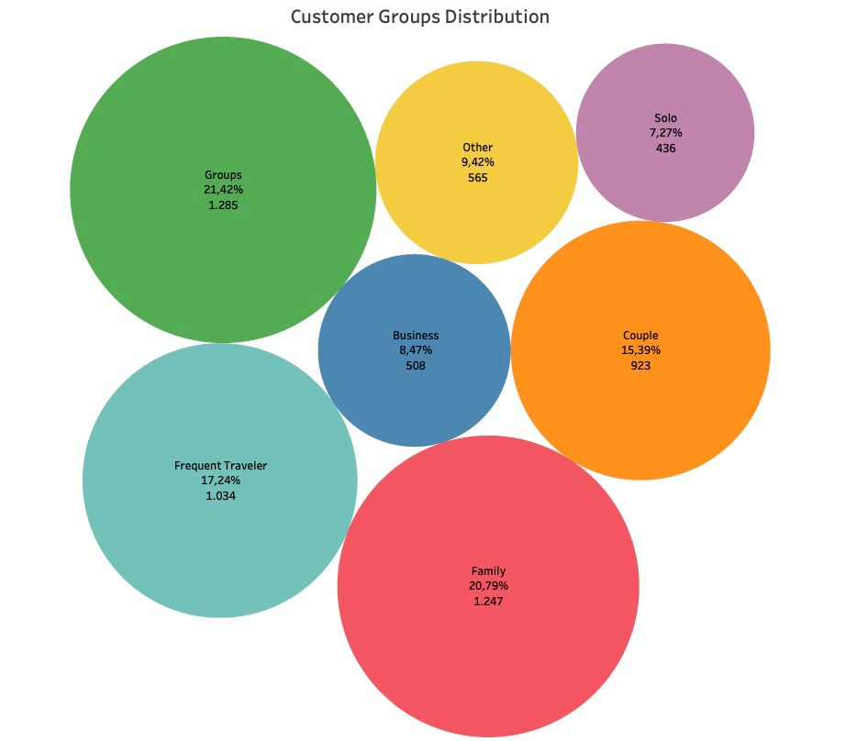
Explanation of the customer group division
Groups: Users traveling with larger parties, reflected by higher averages in checked bags, flight seats, and hotel rooms. Typically unmarried, indicating group rather than family travel.
Families: Identified by traveling with children, higher baggage counts, multiple flight seats, and average overall hotel expenses.
Frequent Travelers: Users who fall in the top 25% of all users based on the number of trips taken.
Couples: Travelers with two flight seats, one hotel room, no children, and a marital status of married.
Other: Users whose travel patterns do not align with the defined categories, indicating unique or diverse behaviors.
Business Travelers: Characterized by minimal luggage, short hotel stays, and above-average spending on accommodations.
Solo Travelers: Individuals traveling alone, with moderate spending and fewer overall trips.

Slide 5
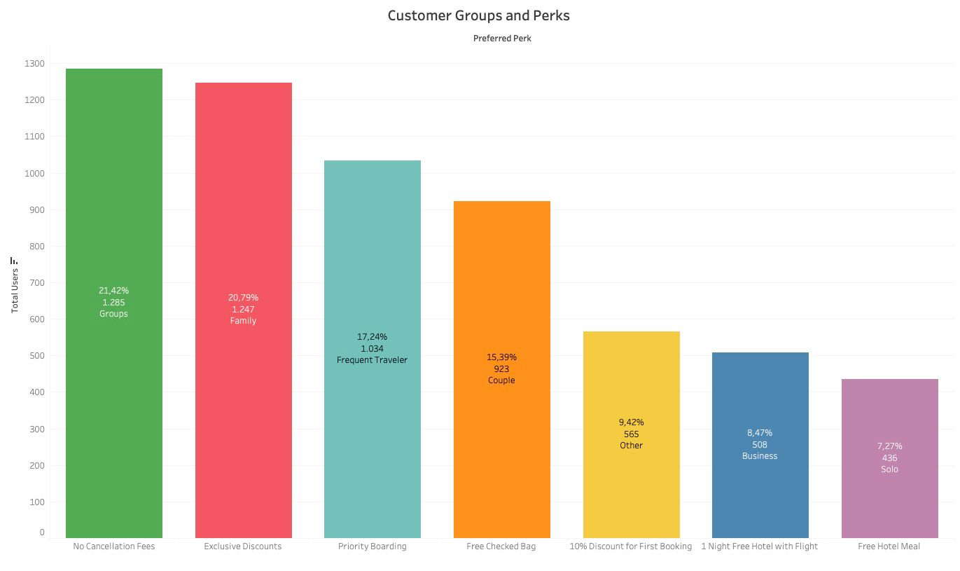
Definitions of the perks for each customer group
Customers prioritize flexibility and cost savings when making travel decisions.
Tailored perks resonate strongly with group and family travelers, while frequent and business travelers are drawn to perks that emphasize convenience and efficiency.

Slide 6
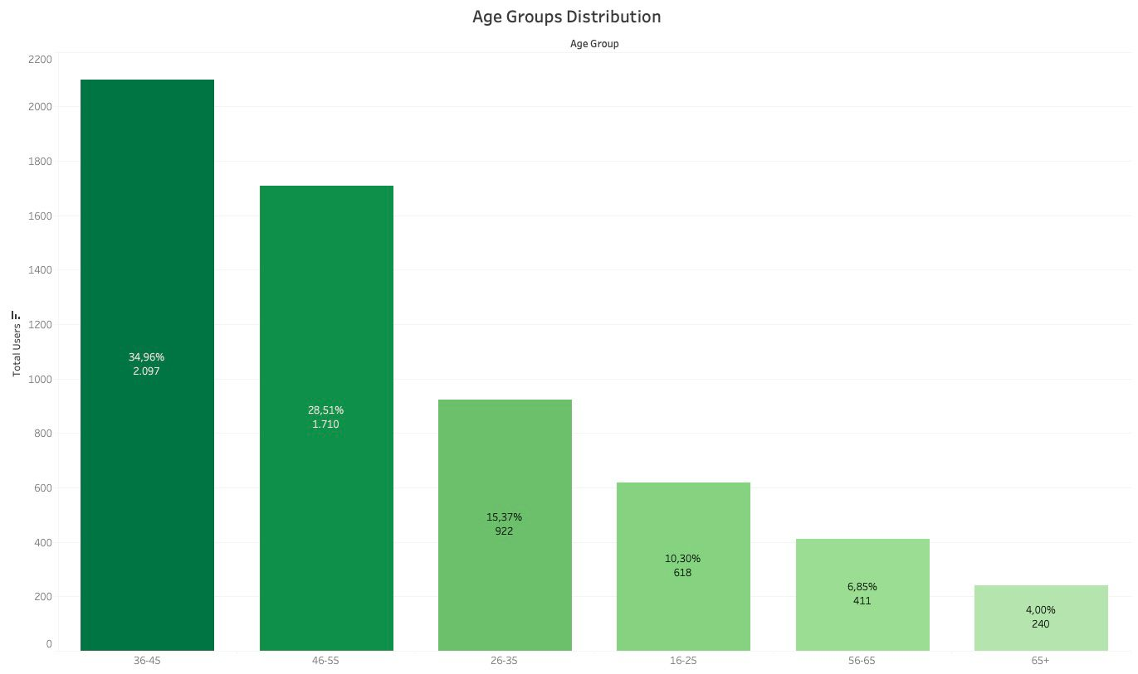
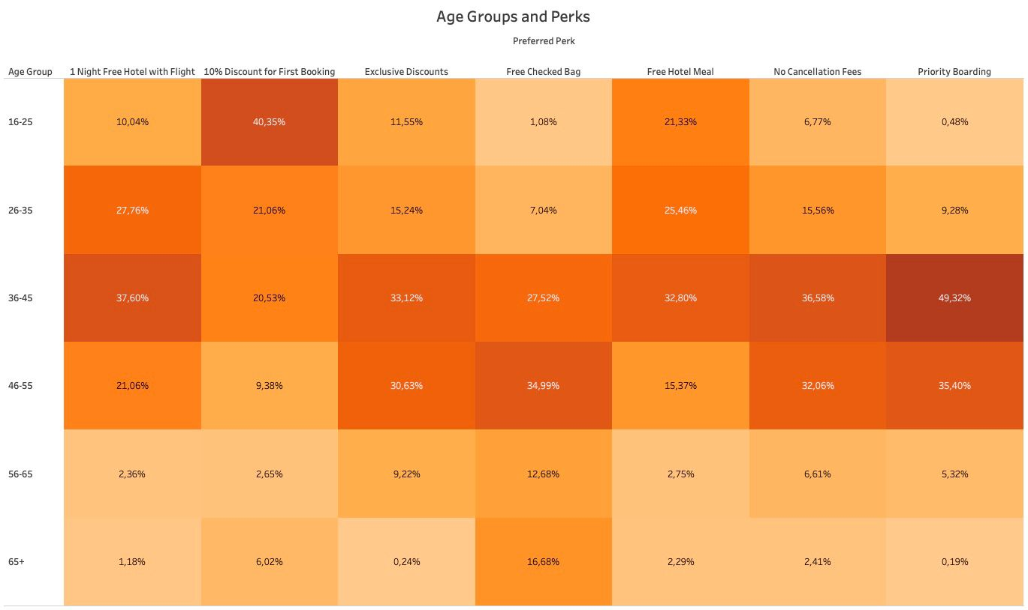
Age group distributions and perks
• 16-25: Highly attracted to a 10% discount on their first booking, reflecting a strong sensitivity to pricing.
• 26-35: Shows a preference for bundled offers like free hotel meals and a complimentary hotel night with flight bookings.
• 36-45 & 46-55: Prioritize convenience and flexibility, favoring perks such as priority boarding, no cancellation fees, and exclusive discounts.
• 55-65 & 65+: Display a lower overall interest in perks but still appreciate exclusive discounts and no cancellation fees, emphasizing reliability in their travel choices.

Slide 7

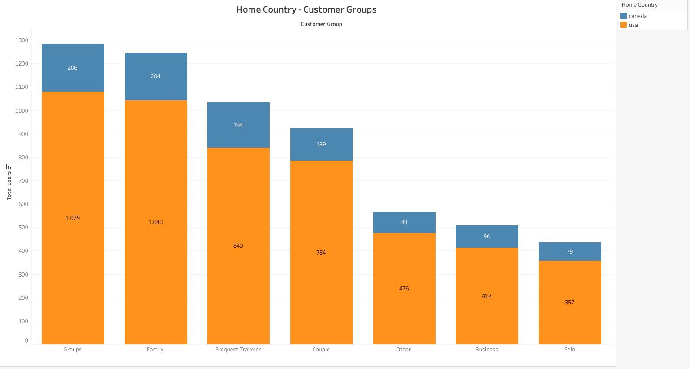
Customer groups according to the countries USA & Canada
The chart shows that most Travel Tide customers are from the U.S., with Groups and Families being the largest segments, followed by Frequent Travelers and Couples.
Smaller segments like Business, Solo, and Other have higher Canadian representation, highlighting growth potential in Canada.
Key opportunities include targeting group and family travelers in the U.S. and expanding business and solo traveler engagement in Canada.

Slide 8
Recommendations
• Customized Rewards: Design perks tailored to specific customer segments to boost engagement and loyalty, ensuring each group receives rewards that align with their preferences.
• Flexible Updates: Regularly assess the performance of perks and analyze customer behavior to make data-driven adjustments, optimizing the program’s impact.
• Tier-Based Benefits: Implement a tiered reward structure where frequent travelers can access exclusive benefits, encouraging more bookings and long-term commitment.
• Insight-Driven Optimization: Leverage A/B testing and customer feedback to refine rewards and adapt the program to evolving customer needs and expectations.

Slide 9
Resources
• Github Link
https://github.com/Oytuncevre/Travel-Tide-Project
• Tableau dashboard https://public.tableau.com/app/profile/oytun.cevre/viz/TravelTideProjectFinal_17329676612960/Dashboard1?publish=yes
• Report & SQL https://colab.research.google.com/drive/1B2Q_RfRPNx_iBsvHQh0d1gTnzxDI5jN7?usp=sharing

Slide 10
Thank you for listening
If you have further questions please feel free to contact me.
E-Mail: oytuncevre94@gmail.com

